Slide 1
IPPF Pre-Conference
Amsterdam
Coming Back To Our Roots
ICW @ Amsterdam 26 Years On
Kate Thomson
Images: Many thanks to Siân Cook and the UK archive HIV Graphic Communication, www.hivgraphiccommunication.com; Wellcome Library; personal archives of Sue O’Sullivan, Fiona Pettitt, Jo Manchester and Jane Shepherd. Slideshow modified and added to from one produced by Jo Manchester and Jane Shepherd.

Slide 2
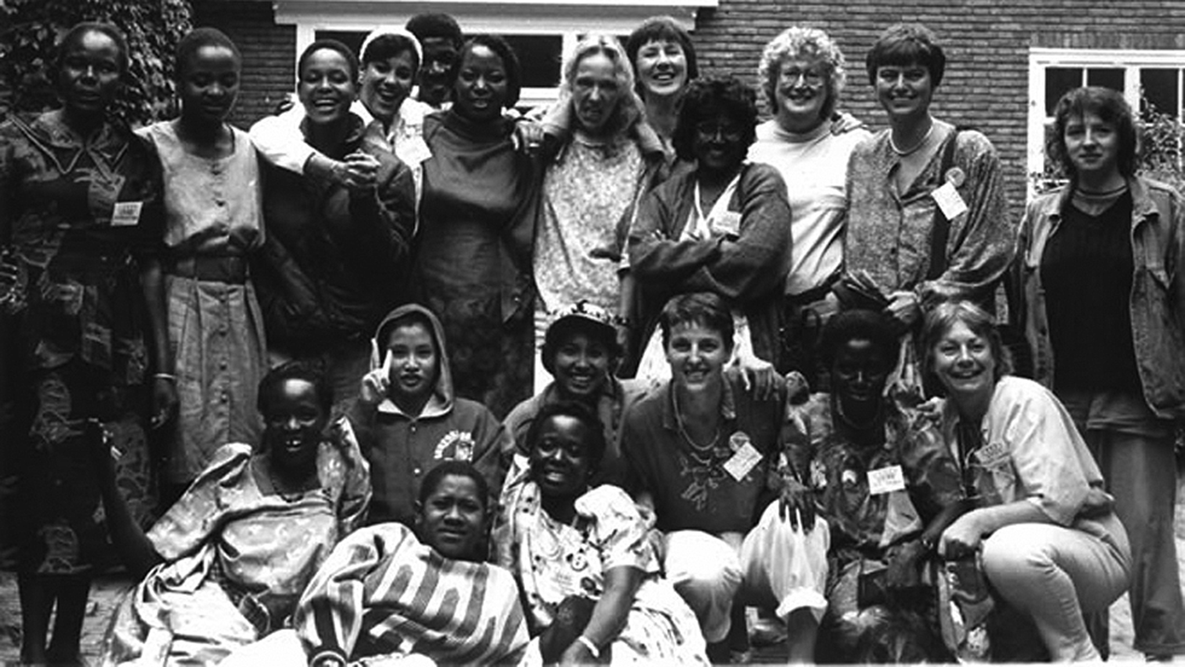
First days of ICW
Source: ICW Global

Slide 3
Female adults (15+) living with HIV: increased from 3.6 million in 1992 to 18.2 million in 2017
Source: UNAIDS 2018 Estimates
Notes:
Note the numbers

Slide 4
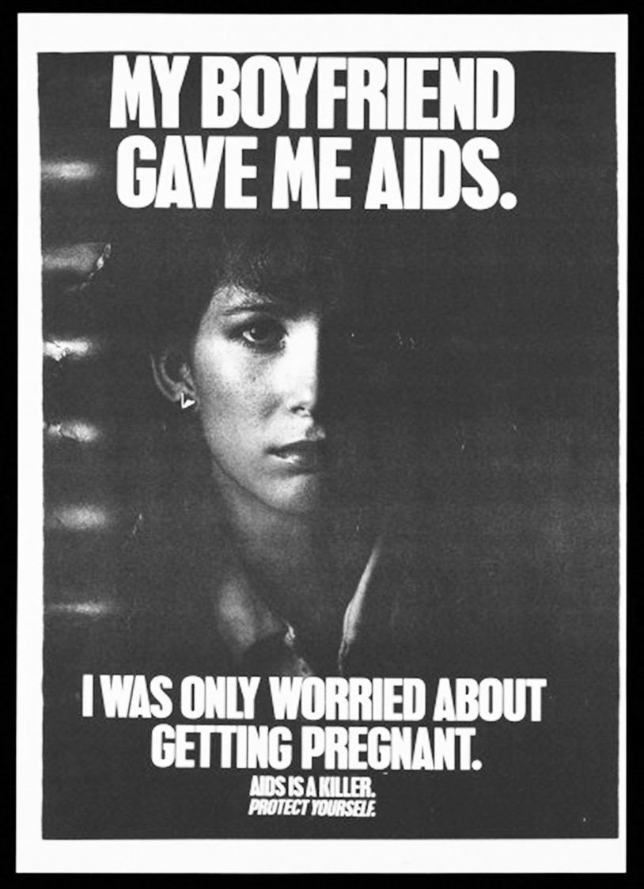
Public health poster tailored to heterosexual women, Oregon, US, 1987
© Oregon Department of Human Services. HIV/STD/TB Program

Slide 5
The twelve statements were agreed at the first meeting of the International Community of Women living with HIV/AIDS (ICW) in Amsterdam, 1992. It was the first time that HIV positive women had come together globally and expressed their needs. They are the foundations on which ICW was built.
The twelve statements were read aloud at the Launch of ICW at the opening ceremony of the World AIDS Conference, Amsterdam 1992

Slide 6
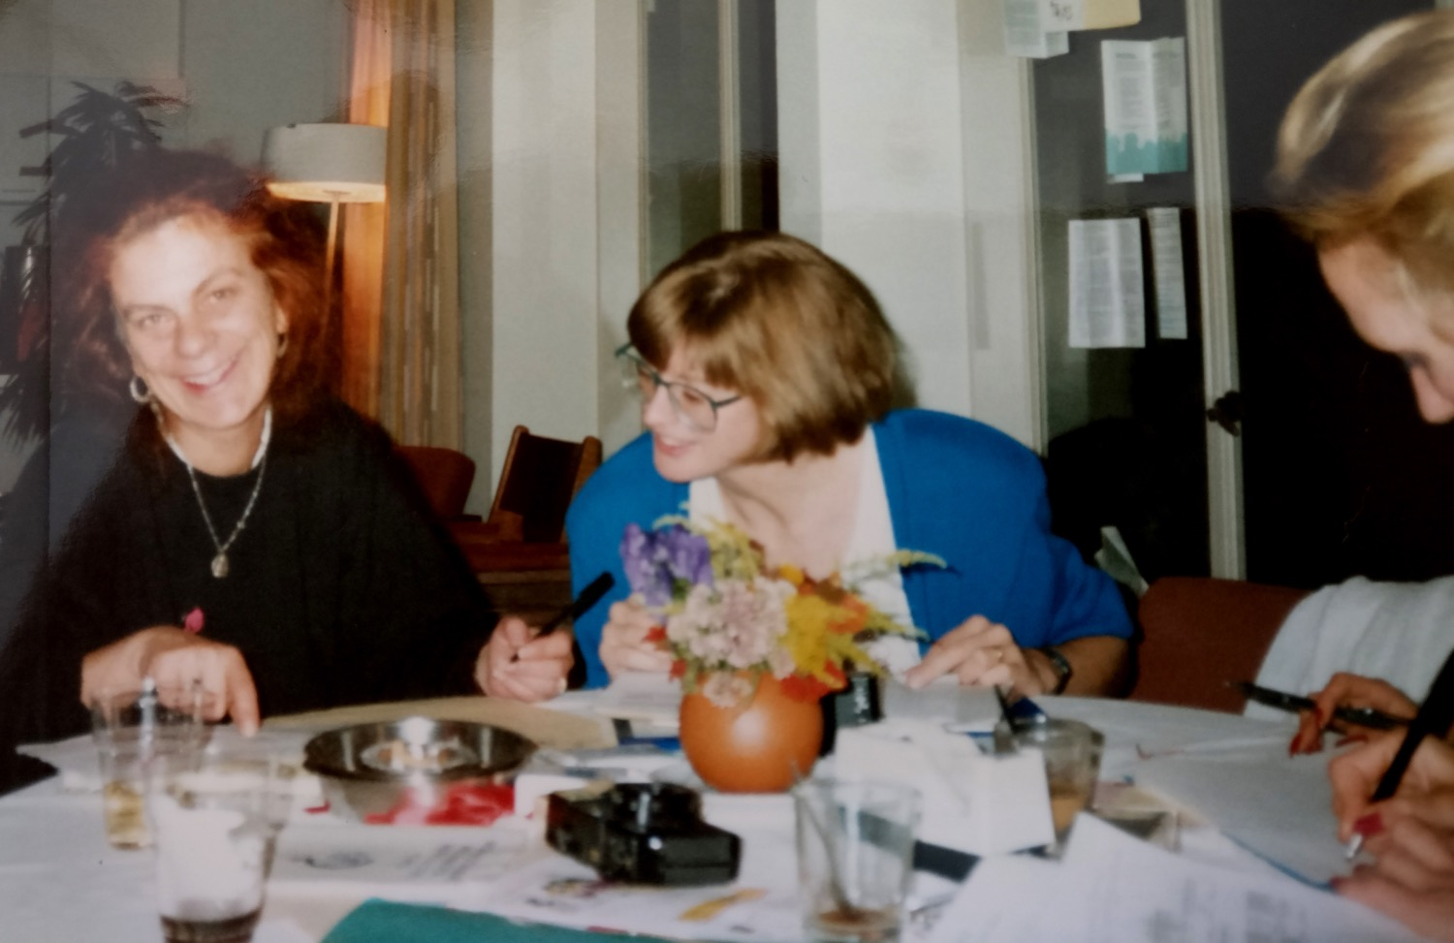
Bev Greet (Australia) and Carolyn (Canada) condense over 100 issues from the 1992 women’s pre-conference workshop into the 12 ICW statements
© Jo Manchester

Slide 7
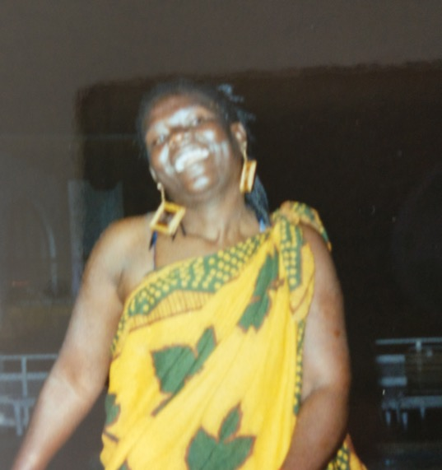
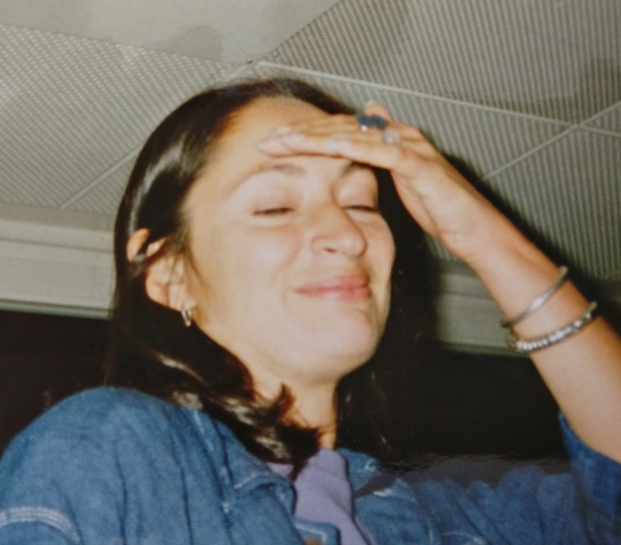
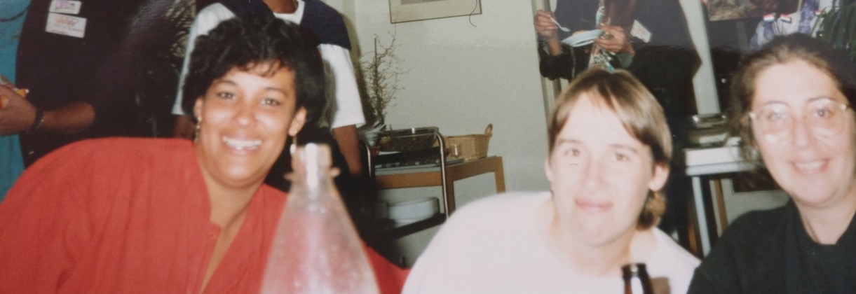
Top: Auxillia Chimosuro (Zimbabwe) and Kate Thomson (UK)
Below: Aracelli Martine (Mexico), Rebecca Denison (US) and Isabel (Spain) at first ICW meeting 1992
All images © Jo Manchester

Slide 8
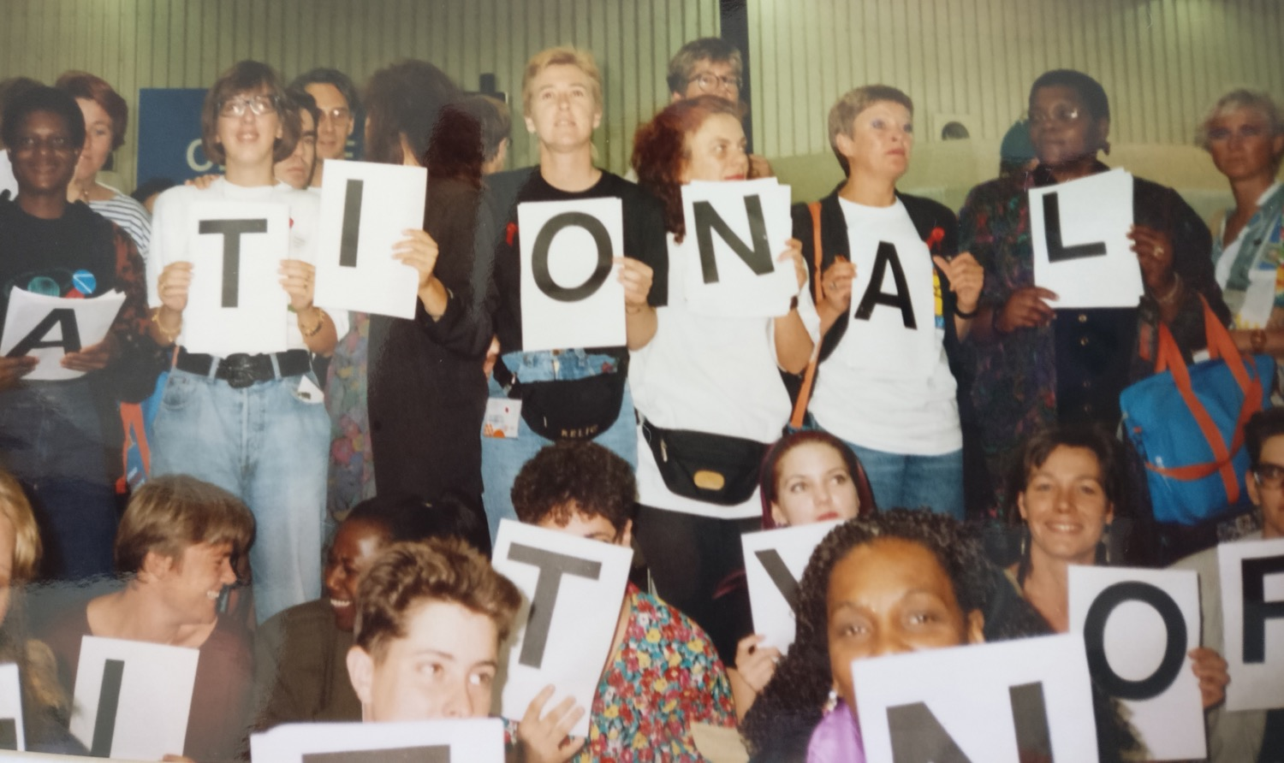
Launching ICW at the International AIDS Conference Amsterdam, 1992
© Jo Manchester

Slide 9
ICW’s original twelve statements
To improve the situation of women living with HIV and AIDS throughout the world:
1. We need encouragement and support for the development of self-help groups and networks.

Slide 10
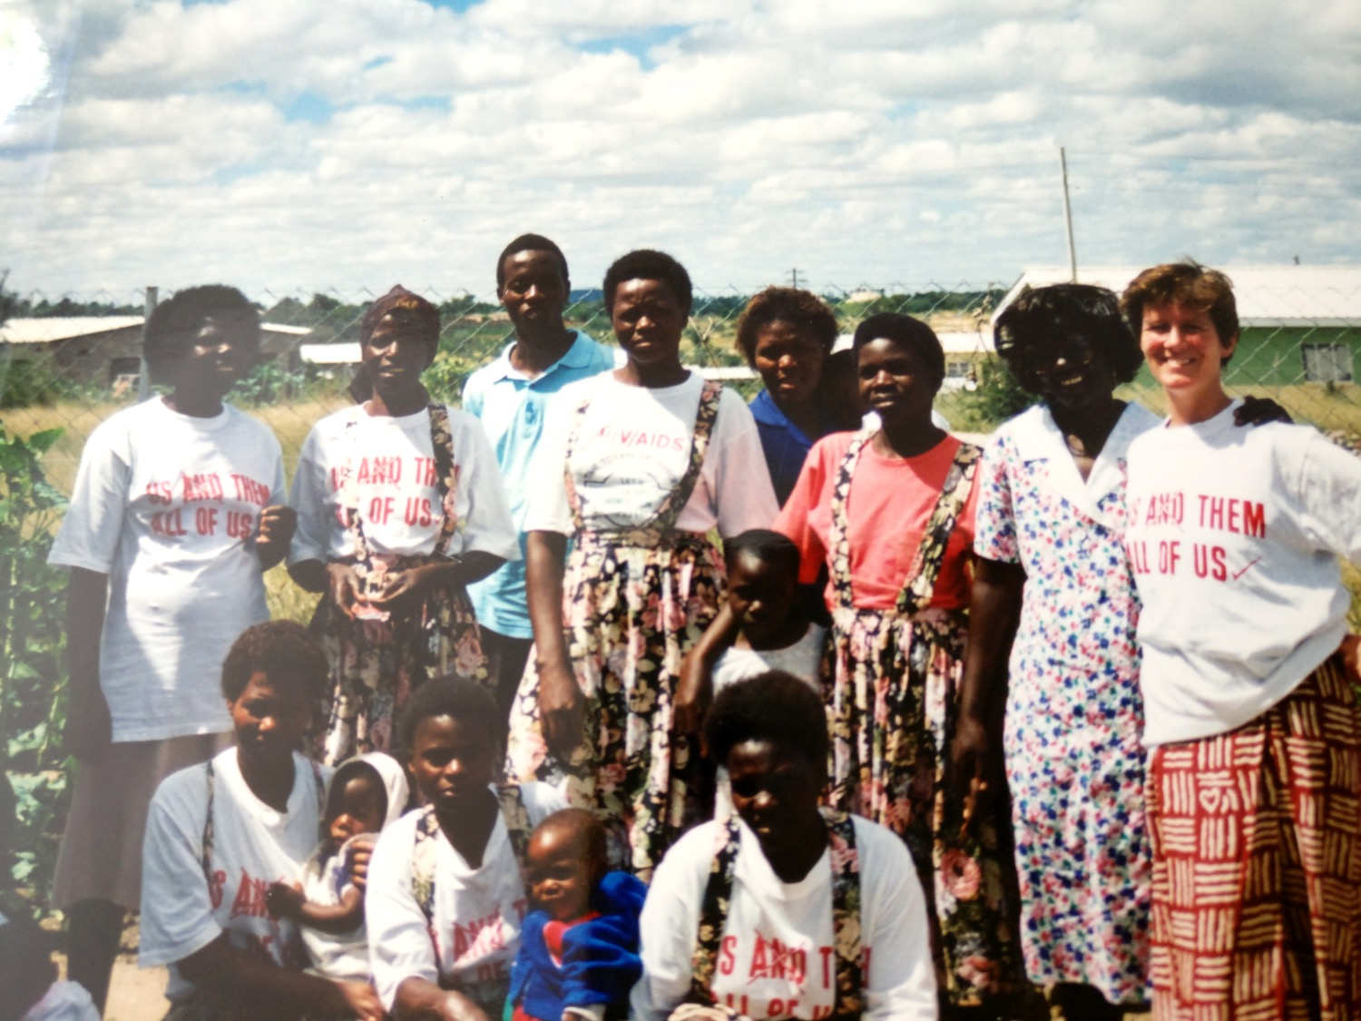
Auxillia Chimusoro with Jo Manchester at Batanai support group in Zimbabwe, 1995
© Jo Manchester

Slide 11
Yolanda Simon and CRN+

Slide 12
2. We need the media to portray us realistically and not stigmatise us.
ICW’s original twelve statements

Slide 13
Global newspaper headlines, late 1980s

Slide 14
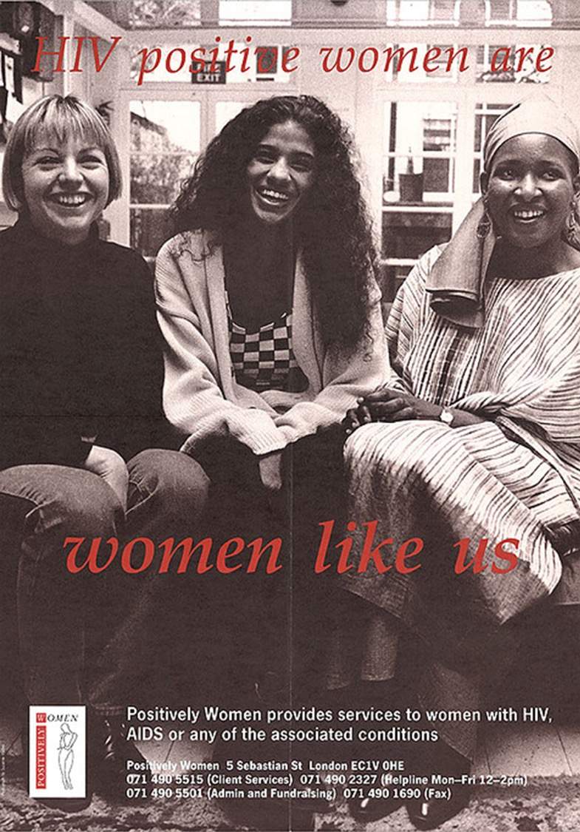
“HIV positive women are women like us”. Leaflet for women’s support services, London, UK 1990
Produced by Positively Women

Slide 15
3. We need accessible and affordable health care (conventional and complementary) and research into how the virus affects women.
ICW’s original twelve statements

Slide 16
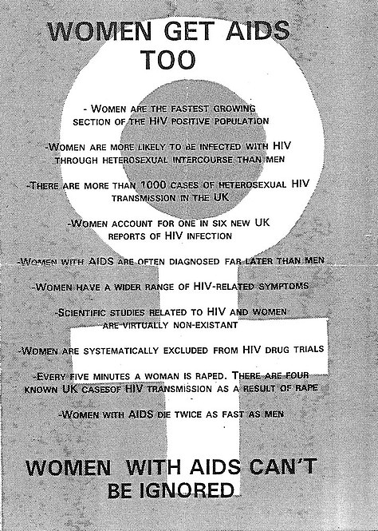
“Women get AIDS too” ACT UP flier, early 1990s

Slide 18
4. We need funding for services to lessen our isolation and meet our needs. All funds directed to us need to be supervised to make sure we get it.
ICW’s original twelve statements

Slide 19
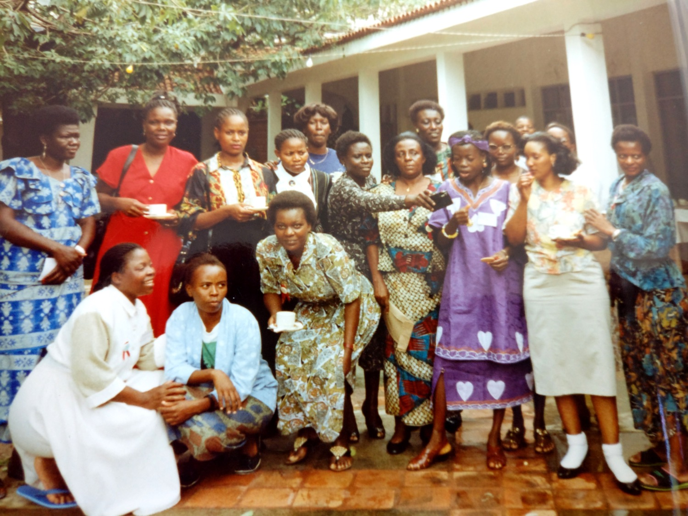
The first meeting of the Network of African People Living with HIV, Mombasa, 1996
© Jo Manchester

Slide 20
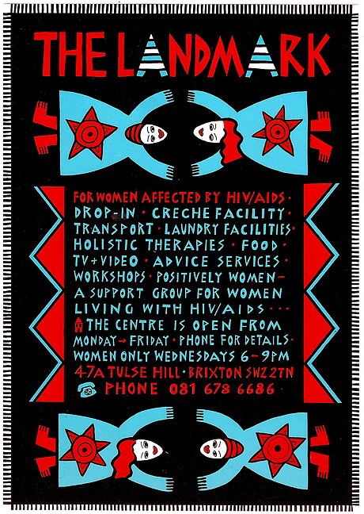
Flier for women’s drop-in support service, London, UK 1991
Produced by The Landmark. Design by Jane Shepherd

Slide 21
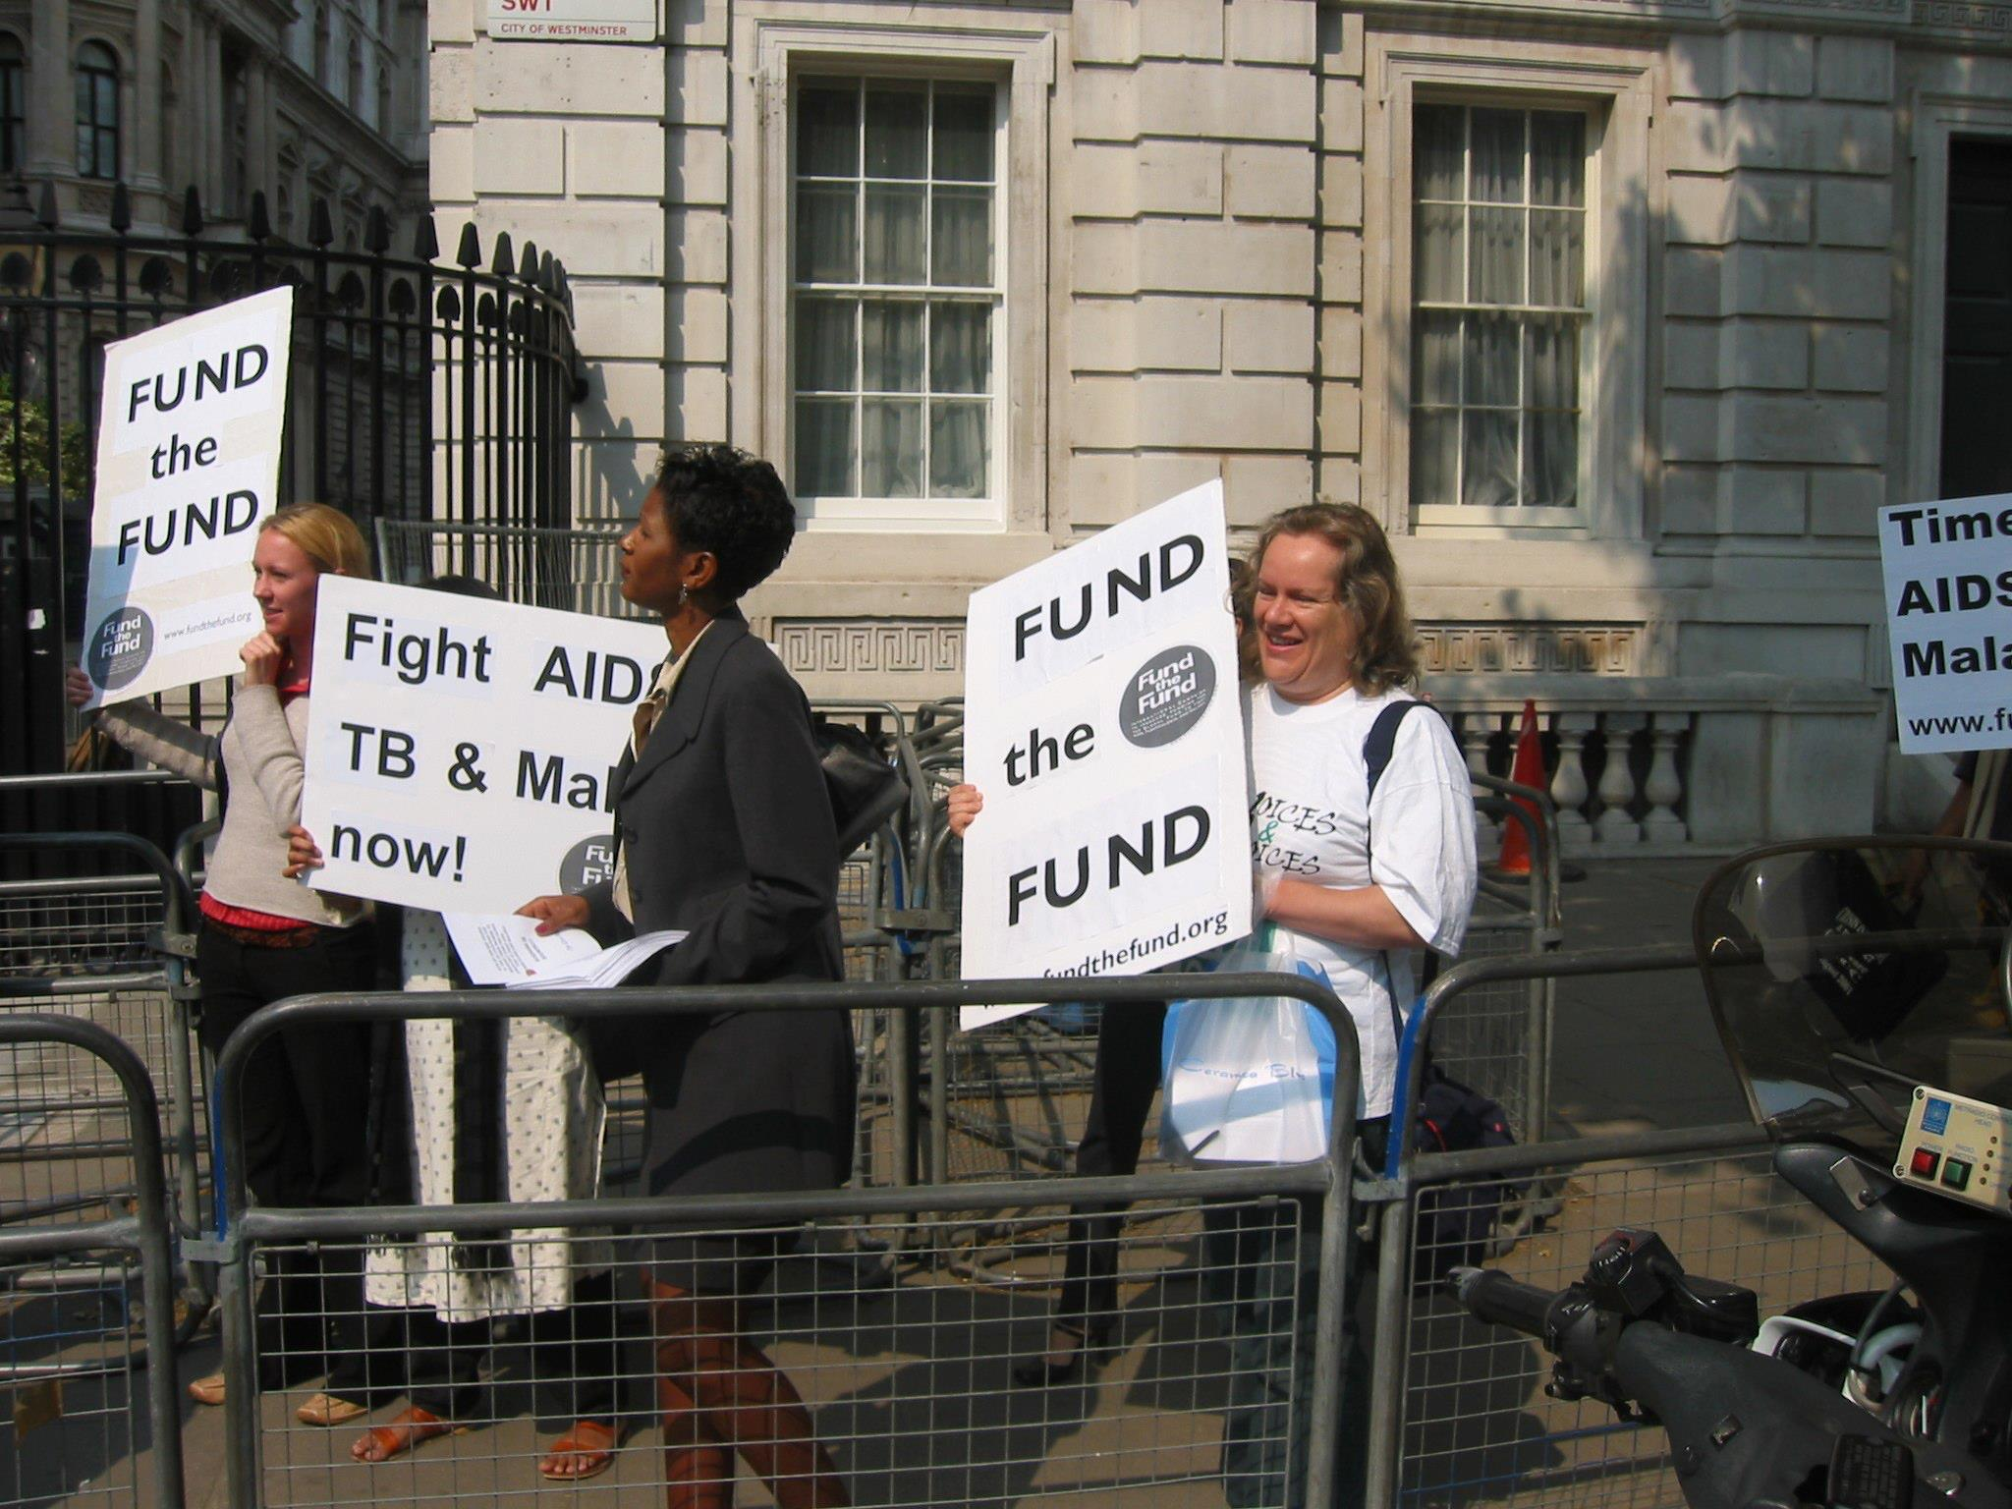
Fiona Pettitt at a demonstration to fund the Global Fund, Downing Street, London
© Fiona Pettitt

Slide 22
5. We need the right to be respected and supported in our choices about reproduction. This includes the right to have children and the right not to have children.
ICW’s original twelve statements

Slide 24
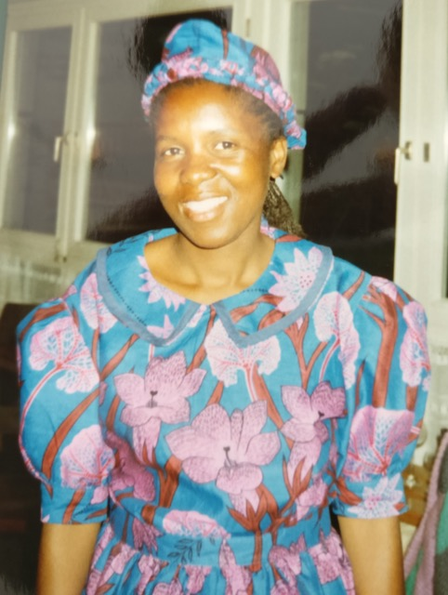
6. We need recognition of the right of our children and orphans to be cared for and of the importance of our role as parents.
© Jo Manchester
In memory of Angelina Ndlovo, Zimbabwe
ICW’s original twelve statements

Slide 25
T-shirt design Mashambanzou AIDS Crisis Centre, Harare, Zimbabwe, 1990
© Mashambanzou Care Trust. Illustration by Jane Shepherd

Slide 26
7. We need education and training of health care providers and the community at large about women's risk and our needs. Up-to-date, accurate information concerning all issues about women living with HIV/AIDS should be easily and freely available.
ICW’s original twelve statements

Slide 27
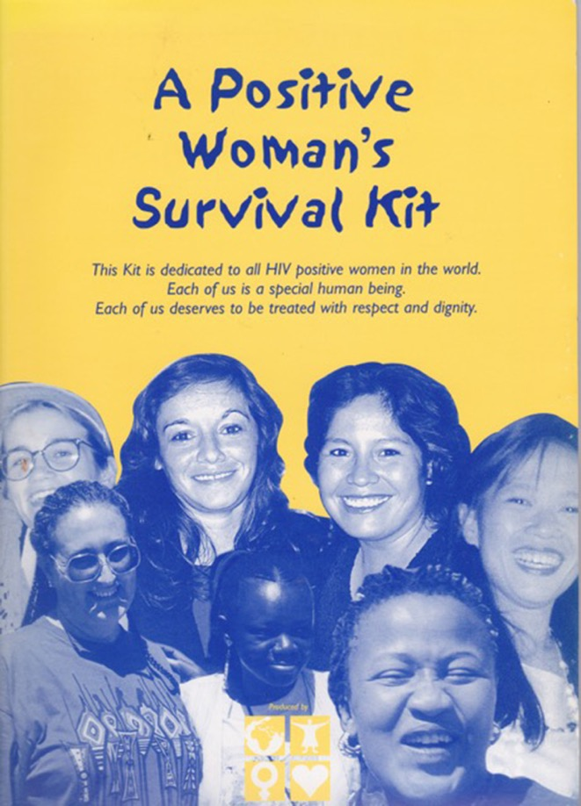
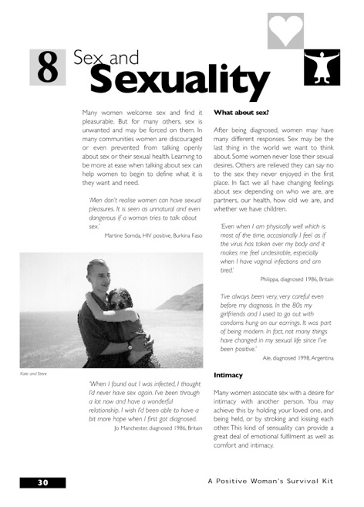
A Positive Woman’s Survival Kit, London, UK, 1999
Produced by ICW

Slide 28
8. We need recognition of the fundamental human rights of all women living with HIV/AIDS, particularly women in prisons, drug users and sex workers. These fundamental rights should include the right to housing, employment and travel without restrictions.
ICW’s original twelve statements

Slide 29
NSWP Amsterdam 1992

Slide 31
9. We need research into female infectivity including woman to woman transmission, recognition of and support for lesbians living with HIV/AIDS.
ICW’s original twelve statements

Slide 32
Prudence

Slide 33
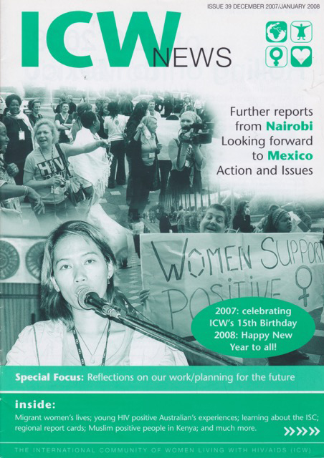
10. We need decision making power and consultation on all levels of policy and programmes affecting us.
ICW’s original twelve statements

Slide 34
Martina Clark, UNAIDS

Slide 36
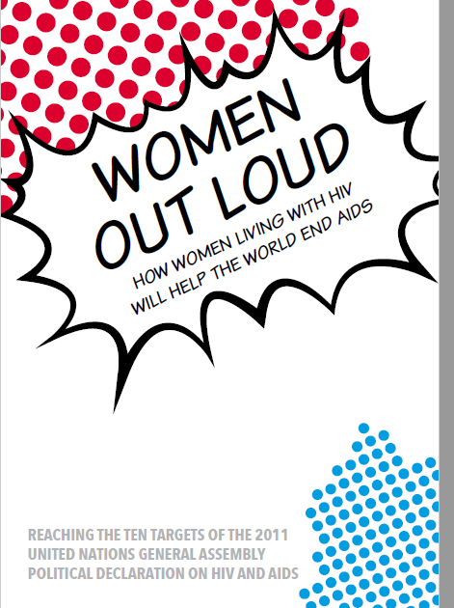

Slide 37
11. We need economic support for women living with HIV/AIDS in developing countries to enable them to be self-sufficient and independent.
ICW’s original twelve statements

Slide 38
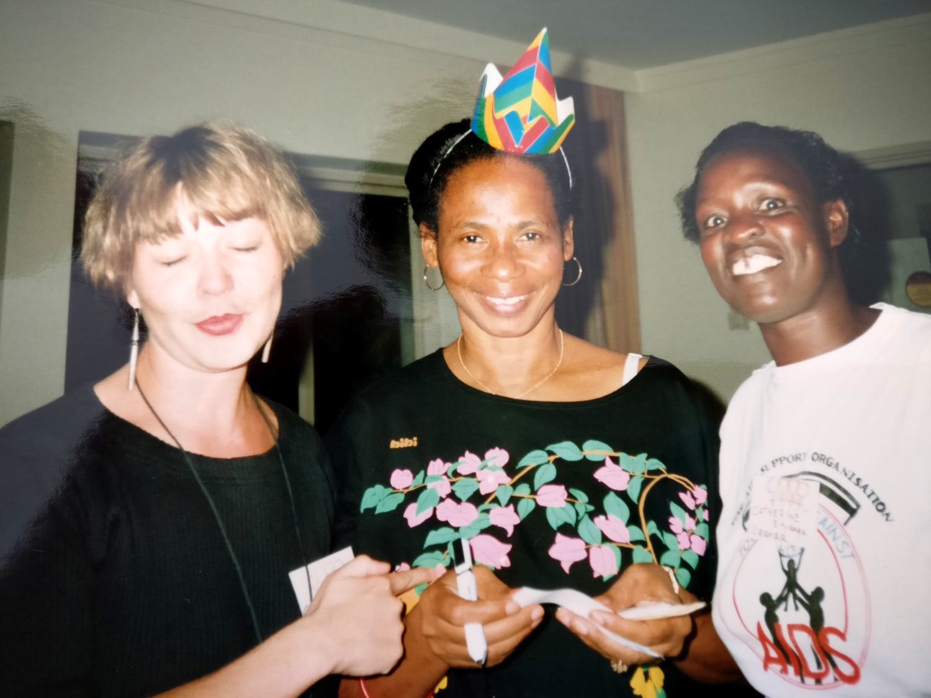
Claudia (Germany), Edna (Jamaica) and Catherine (Uganda) at the first ICW meeting, 1992
© Jo Manchester

Slide 39
12. We need any definition of AIDS to include symptoms and clinical manifestations specific to women.
ICW’s original twelve statements

Slide 40
Slogan from 1990s (anon)

Slide 41
ICW’s 12 Statements are still relevant today and many of them remain unmet

Slide 42
Global Fund Strategy 2017-2022
a
Scale-up evidence-based interventions with a focus on the highest burden countries with the lowest economic capacity and on key and vulnerable populations disproportionately affected by the three diseases |  | Evolve the allocation model and processes for greater impact, including innovative approaches differentiated to country needs |  | Support grant implementation success based on impact, effectiveness, risk analysis and value-for-money |  | Improve effectiveness in challenging operating environments through innovation, increased flexibility and partnerships |  | Support sustainable responses for epidemic control and successful transitions
Innovative approaches to meet diverse country needs are essential to accelerate the end of the epidemics
b
c
d
e
Strengthening systems for health is critical to attain universal health coverage and to accelerate the end of the epidemics
Promoting and protecting human rights and gender equality is required to accelerate the end of the epidemics
MAXIMIZE IMPACT AGAINST HIV, TB AND MALARIA
a
Strengthen community responses and systems
Support reproductive, women’s, children’s, and adolescent health, and platforms for integrated service delivery
Strengthen global and in-country procurement and supply chain systems
Leverage critical investments in human resources for health
Strengthen data systems for health and countries’ capacities for analysis and use
Strengthen and align to robust national health strategies and national disease-specific strategic plans
Strengthen financial management and oversight
b
a
Scale-up programs to support women and girls, including programs to advance sexual and reproductive health and rights
Invest to reduce health inequities including gender- and age-related disparities
Introduce and scale-up programs that remove human rights barriers to accessing HIV, TB and malaria services
Integrate human rights considerations throughout the grant cycle and in policies and policy-making processes
Support meaningful engagement of key and vulnerable populations and networks in Global Fund-related processes
c
BUILD RESILIENT & SUSTAINABLE SYSTEMS FOR HEALTH
PROMOTE & PROTECT HUMAN RIGHTS AND GENDER EQUALITY
b
d
c
e
d
f
e
MOBILIZE INCREASED RESOURCES
g
g
Increased programmatic and financial resources from diverse sources are needed to accelerate the end of the epidemics
a
Attract additional financial and programmatic resources for health from current and new public and private sources |  | Support countries to use existing resources more efficiently and to increase domestic resource mobilization |  | Implement and partner on market shaping efforts that increase access to affordable, quality-assured key medicines and technologies |  | Support efforts to stimulate innovation and facilitate the rapid introduction and scale-up of cost-effective health technologies and implementation models
b
c
d
STRATEGIC ENABLERS: Innovate and differentiate along the development continuum • Support mutually accountable partnerships

Slide 43
The Lancet July 2018

Slide 45
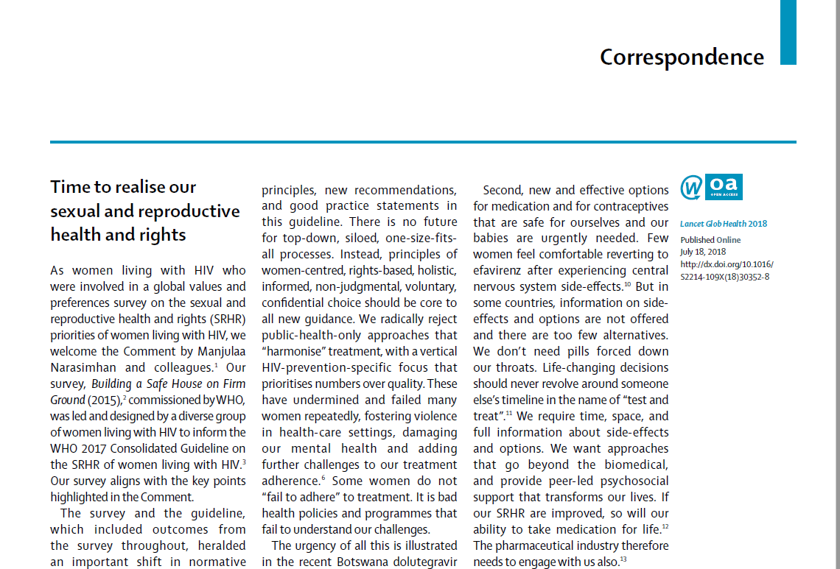

Slide 46
Without political will, and new advances in science and funding, all proclamations fail us all. The time to uphold our SRHR is now
Florence Anam, Cecilia Chung,
Sophie Dilmitis, Calorine Kenkem,
Rebecca Matheson-Omondi,
Svitlana Moroz, Lillian Mworeko,
Hajjarah Nagadya, Angelina Namiba,
Violeta Ross, Sophie Strachan,
Martha Tholanah, L’Orangelis Thomas,
Patricia Ukoli, Marijo Vazquez,
Aleksandra Volgina, Rita Wahab,
*Alice Welbourn, Anandi Yuvraj

Slide 47
Thank you!
I hope in 2018 we will all be part of what will be another historic moment - the dawn of a new feminist activist politics – Yolanda Simon
another historic moment... The dawn of a new feminist activist politicsce: ICW Global
Notes:
I hope we will all be part of what will be another historic moment... The dawn of a new feminist activist politics

